Slide 1
INTRODUCTION
CKD PRE-PACKING
AUTOMATION SOP
Date : 7-Oct-25
Notes:
1

Slide 2
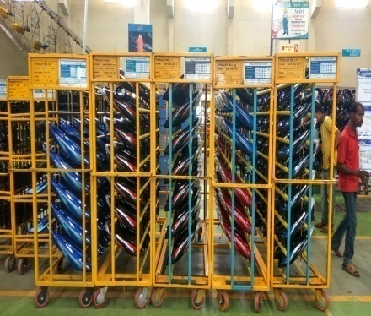
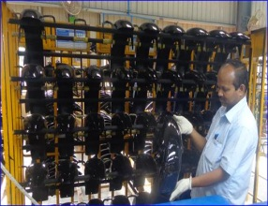
CKD PRE PACKING SOP
Example – Discover M / H model, Bangladesh
Sr. No. | Activities | Photo
1 | Arrange the painted part as per the plan and keep trolleys in defined area systematically
2 | Check Painted Parts aesthetically by using hand/visual
Notes:
2

Slide 3
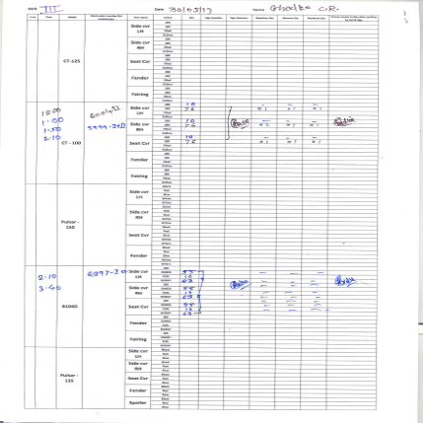
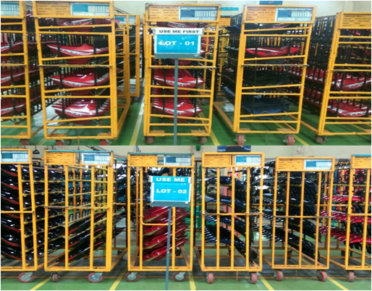
CKD PRE PACKING SOP
Example – Discover M / H model, Bangladesh
Sr. No. | Activities | Photo
3 | Replace the rejected part with OK part and update data in ABS check sheet
4 | In painted part raw material area arrange the material trolleys as per Lot-1 and Lot-2
Notes:
3

Slide 4
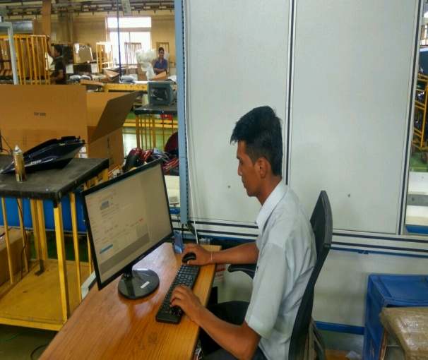
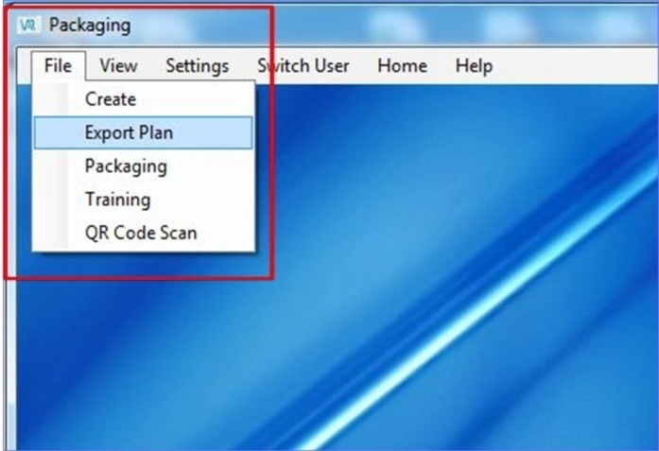
CKD PRE PACKING SOP
Example – Discover M / H model, Bangladesh
Sr. No. | Activities | Photo
5 | Set work order & part code as per colour & plan in system
6 | Upload work order in the system by selecting File - Export Plan option.
Notes:
4

Slide 5
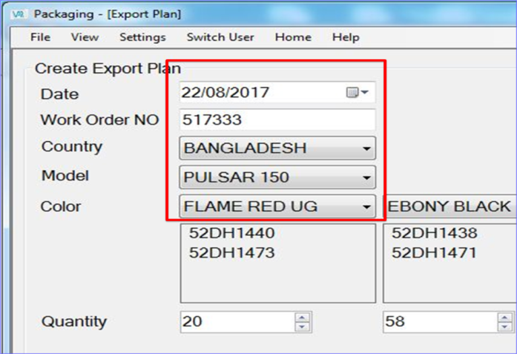
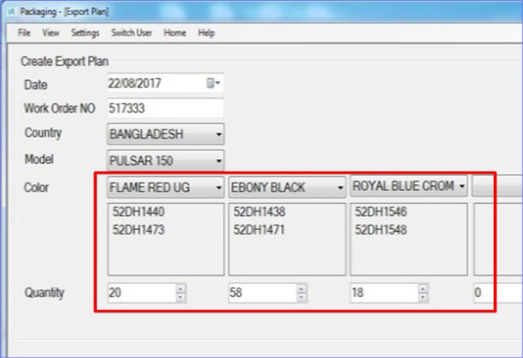
CKD PRE PACKING SOP
Example – Discover M / H model, Bangladesh
Sr. No. | Activities | Photo
7 | In Export plan create option , upload work order no., country & model.
8 | In Export plan create option, upload colour & qty as per plan
Notes:
5

Slide 6
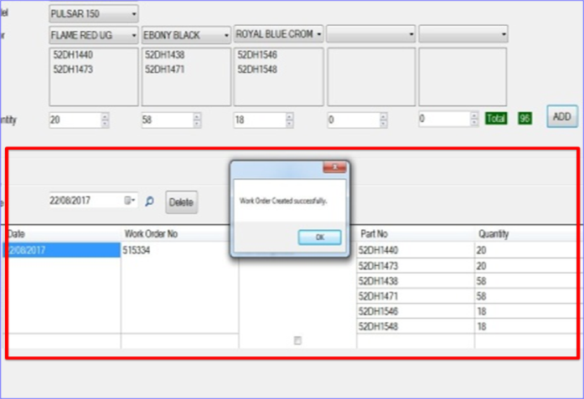
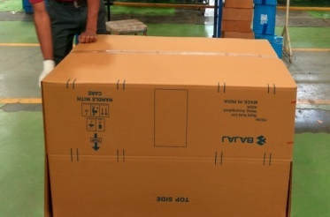
CKD PRE PACKING SOP
Example – Discover M / H model, Bangladesh
Sr. No. | Activities | Photo
9 | In Export plan create option, verify the total qty. as per colour & select add option.
10 | Make corrugated box for painted parts as shown in the system.
Notes:
6

Slide 7
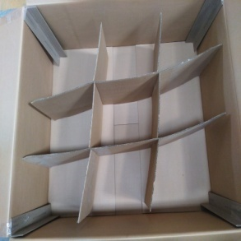
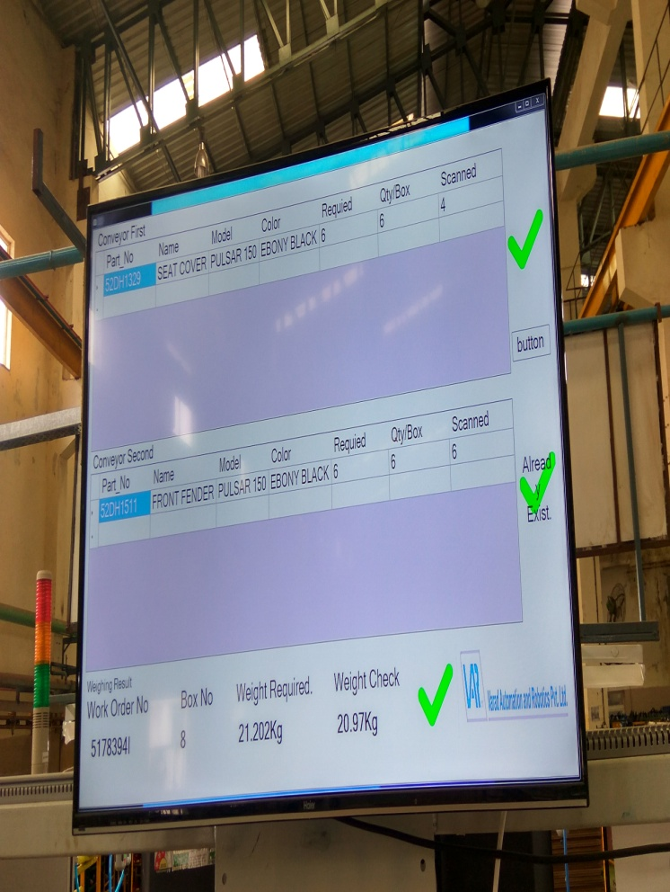
CKD PRE PACKING SOP
Example – Discover M / H model, Bangladesh
Sr. No. | Activities | Photo
11 | Place partition & corner in corrugated box.
12 | Empty corrugated box pace on weighing conveyor for weight & check weight on screen.
Notes:
7

Slide 8
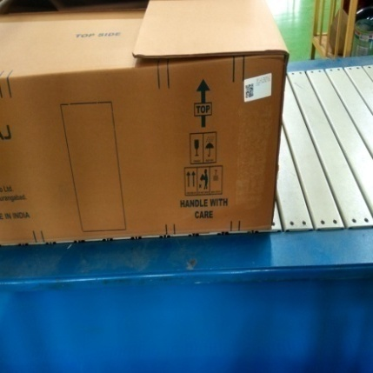
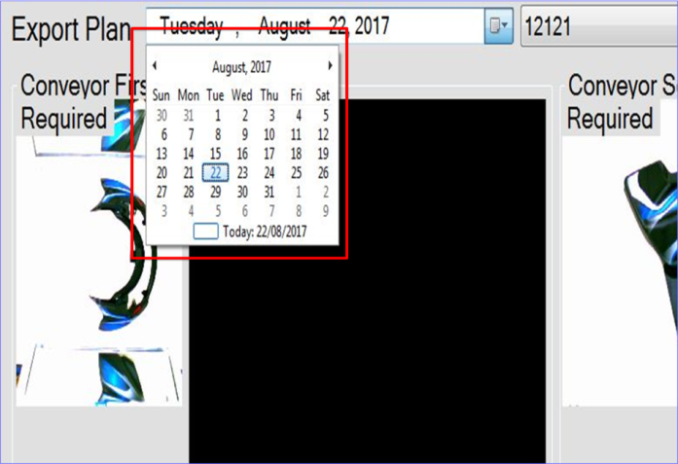
CKD PRE PACKING SOP
Example – Discover M / H model, Bangladesh
Sr. No. | Activities | Photo
13 | Place empty corrugated box on conveyor & paste identification sticker on it.
14 | Select date for painted part packing in system.
Notes:
8

Slide 9
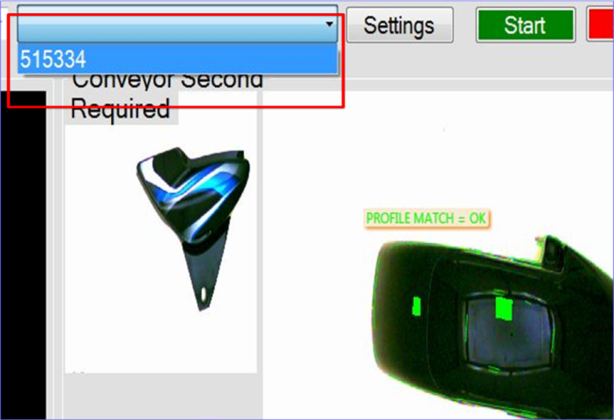
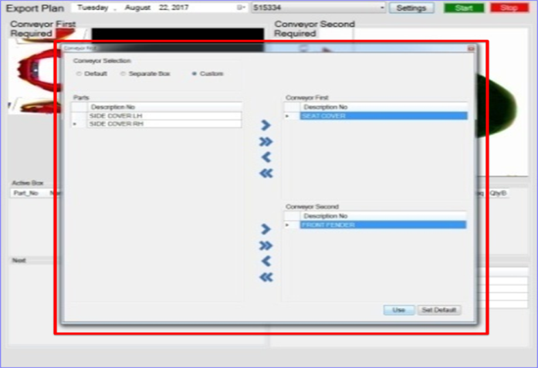
CKD PRE PACKING SOP
Example – Discover M / H model, Bangladesh
Sr. No. | Activities | Photo
15 | Select uploaded work order for packing in system.
16 | Upload painted parts, conveyor 1 & conveyor 2 in system setting.
Notes:
9

Slide 10
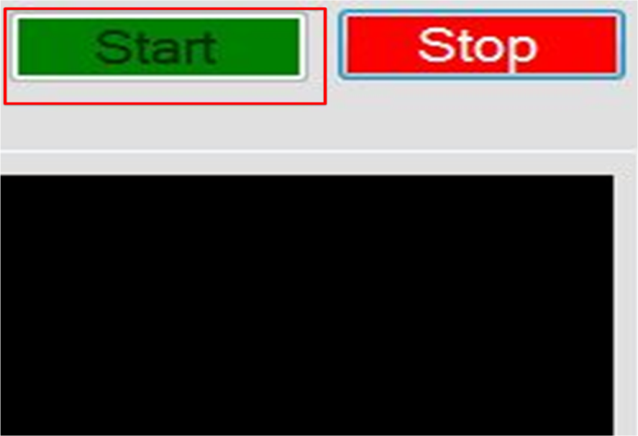
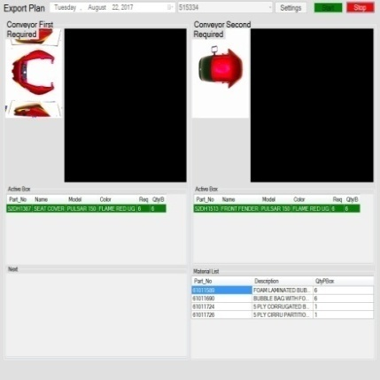
CKD PRE PACKING SOP
Example – Discover M / H model, Bangladesh
Sr. No. | Activities | Photo
17 | Start packing after selection & upload.
18 | Take part for packing as per the part code shown in the system.
Notes:
10

Slide 11
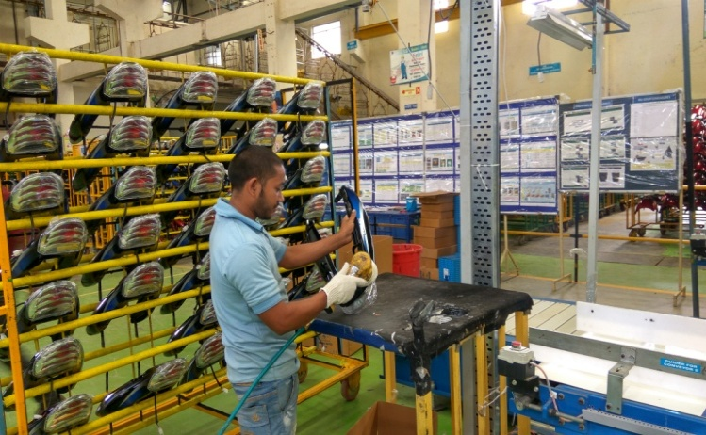
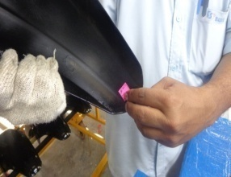
CKD PRE PACKING SOP
Example – Discover M / H model, Bangladesh
Sr. No. | Activities | Photo
19 | Arrange trolleys in defined layout for vision conveyor 1 & vision conveyor 2 for packing.
20 | OK part confirmation by pasting OK sticker.
Notes:
11

Slide 12
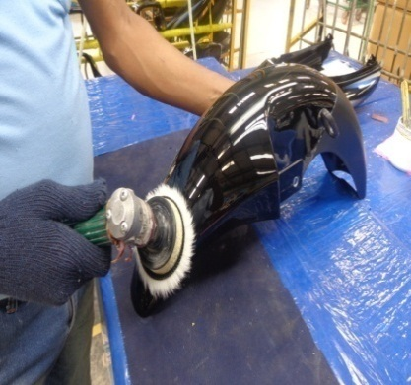
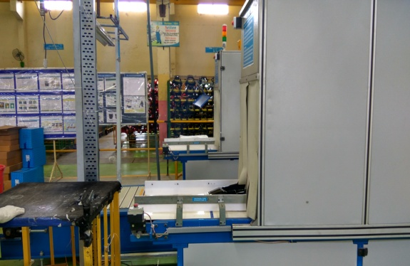
CKD PRE PACKING SOP
Example – Discover M / H model, Bangladesh
Sr. No. | Activities | Photo
21 | Polish painted parts by using polish gun, if required.
22 | Pass the painted part on vision conveyor.
Notes:
12

Slide 13
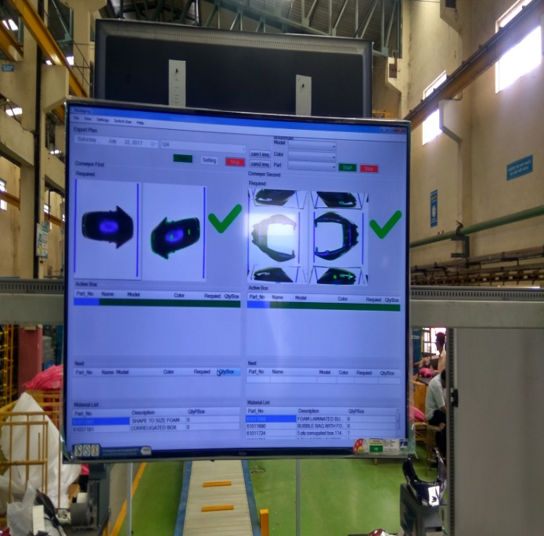
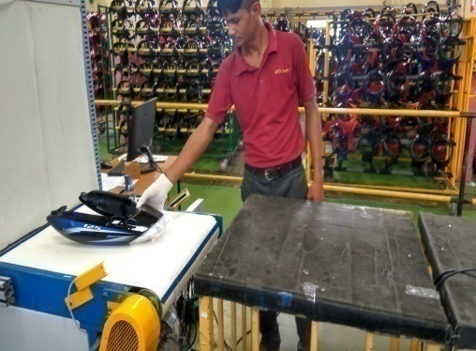
CKD PRE PACKING SOP
Example – Discover M / H model, Bangladesh
Sr. No. | Activities | Photo
23 | Scanned painted part in the vision system displays OK on screen.
24 | OK Painted part come out from vision conveyor.
Notes:
13

Slide 14
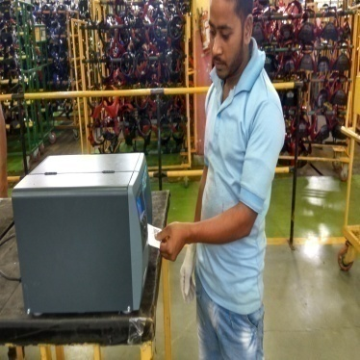
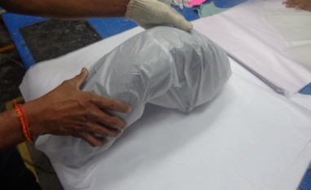
CKD PRE PACKING SOP
Example – Discover M / H model, Bangladesh
Sr. No. | Activities | Photo
25 | QR code sticker come out from printer for OK painted parts.
26 | Packing of OK Painted Part in Butter Paper
Notes:
14

Slide 15
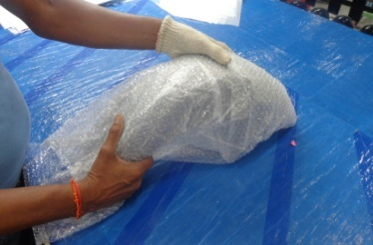
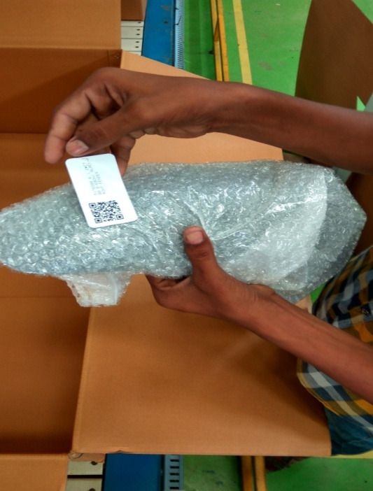
CKD PRE PACKING SOP
Example – Discover M / H model, Bangladesh
Sr. No. | Activities | Photo
27 | OK painted part packed in butter paper is further pack in bubble bag.
28 | Paste QR code sticker on bubble bag of OK painted parts.
Notes:
15

Slide 16
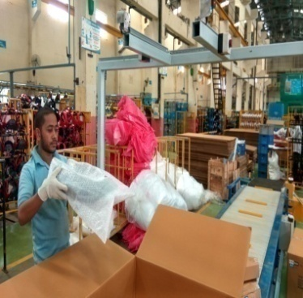

CKD PRE PACKING SOP
Example – Discover M / H model, Bangladesh
Sr. No. | Activities | Photo
29 | Scan sticker on bubble bag & place set of painted parts in corrugated box.
30 | All scanned parts will display on screen with quantity.
Notes:
16

Slide 17
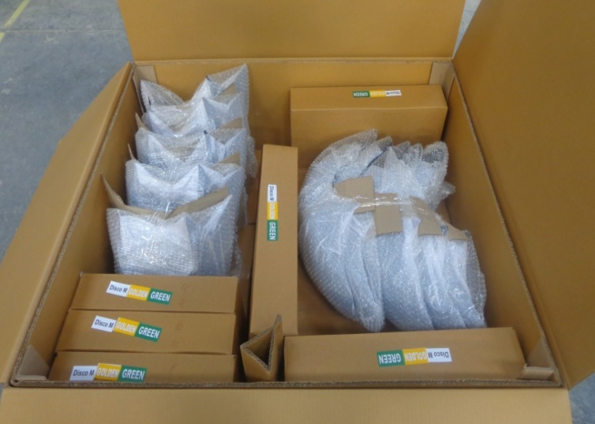
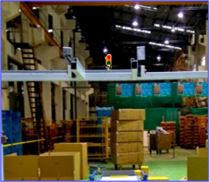
CKD PRE PACKING SOP
Example – Discover M / H model, Bangladesh
Sr. No. | Activities | Photo
31 | Set of five parts (Seat Cover, LH/RH Side Cover, Fairing, Fender) packing in one defined corrugated box as per table drawing.
32 | Box confirmation siren will buzzer after complete box packing.
Notes:
17

Slide 18
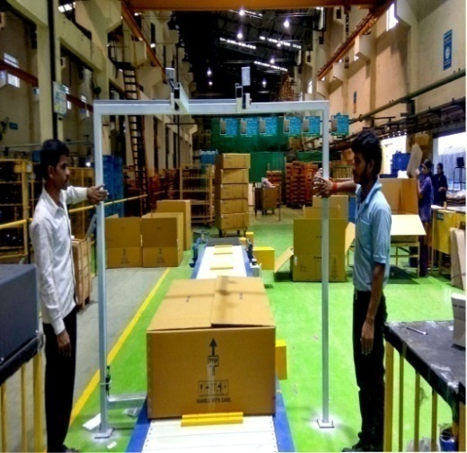
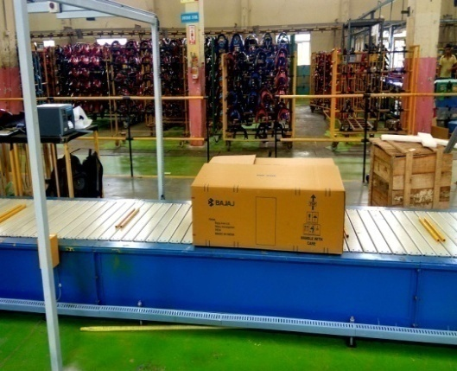
CKD PRE PACKING SOP
Example – Discover M / H model, Bangladesh
Sr. No. | Activities | Photo
33 | Press box confirmation button after complete box packing for further movement of box on conveyor.
34 | Jumbo corrugated box packing with BOPP tape & conveyor will move further for box weighing & scanning.
Notes:
18

Slide 19
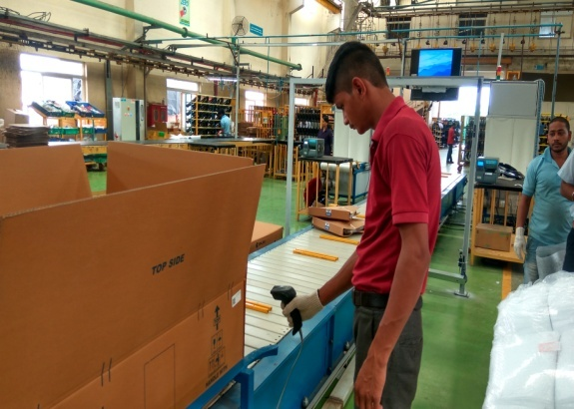
CKD PRE PACKING SOP
Example – Discover M / H model, Bangladesh
Sr. No. | Activities | Photo
35 | Scan QR code sticker on box after weighing for Final box sticker.
36 | Detailed information of packed box like weight, qty & part will display on screen.
Notes:
19

Slide 20
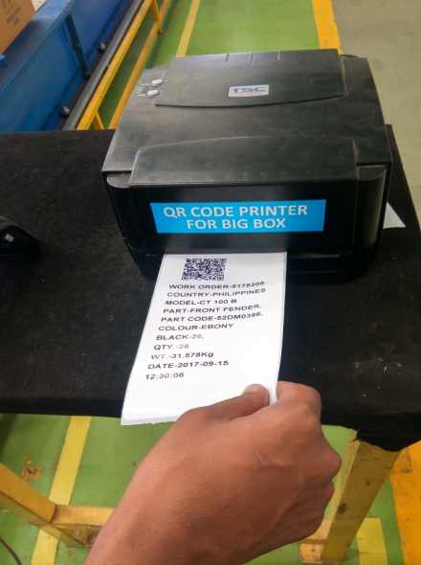
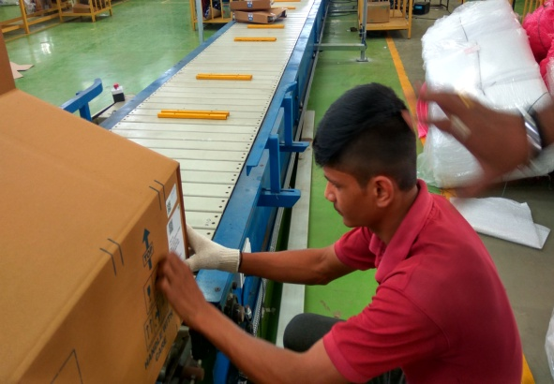
CKD PRE PACKING SOP
Example – Discover M / H model, Bangladesh
Sr. No. | Activities | Photo
37 | Print of Final Box Identification sticker come out from QR code printer for Big Box.
38 | Paste Final Box Identification sticker (Model, colour, Qty, etc.) on corrugated box.
Notes:
20

Slide 21
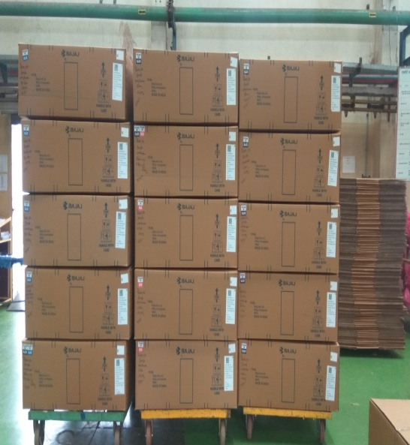
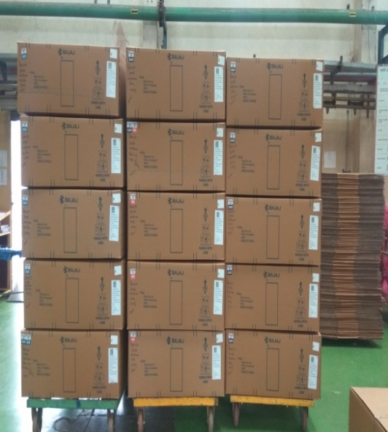
CKD PRE PACKING SOP
Example – Discover M / H model, Bangladesh
Sr. No. | Activities | Photo
39 | Stacking of 04 Jumbo box on single defined trolley systematically & shifting to storage area.
40 | Differentiate Model wise & Colour wise packing material at defined storage area.
Notes:
21

Slide 22
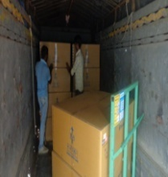
CKD PRE PACKING SOP
Example – Discover M / H model, Bangladesh
Sr. No. | Activities | Photo
41 | Material dispatch as per BAL plan. (Need to send 02 person at BAL for material unloading)
Notes:
22

Slide 23
THANKS
Notes:
23

